Slide 1
DevNet Learning Forum
4 – Application Hosting

Slide 2
Agenda
Review
App-hosting
Guestshell
IOx

Slide 3
Review

Slide 4
App-hosting

Slide 5







Current Application Challenges
Not enough network bandwidth
Most of the data is not interesting
The use of data may be at the edge
Computation can be optimized for some purposes Data normalization
Data redirection based on the content of the data
Data time stamping, algorithmic ownership
Data Reduction
Filtering
Latency Optimization
Partitioning
Application Simplification Dynamic Changes Analytic Support

Slide 6












Empowering the Edge – Leverage the Network!
Existing hardware
footprint
No need for separate compute machinery
Integrated security
Reduced latency
& bandwidth cost
Business Applications
Management
Analytic
Systems
IoT Applications
Billing

Slide 7
Cloud, Fog, Edge Computing

Slide 8
Applications in Fog Computing
Fog Computing
What is Fog Computing?
An application architecture design combining compute, storage, control, management, and inter-communication of edge devices and clients
Extension of the cloud down to the things
One of the pillars of the Cisco IoT System
Why do we need another concept?
Fog refers to a unique problem domain
Fog addresses network issues of latency, bandwidth and operational issues of autonomous operation, in-flow data analysis, and management overload
APPLICATIONS
Network Connectivity
Fog Computing
Data Analytics
Security Cyber and Physical
Management and Automation
Application Enablement Platform
INTERNET OF THINGS

Slide 9






































Fog Computing Architecture
Application
Application
Application
Data Center
and Cloud
Business
Applications
Analytics
Applications
IoT PaaS Platforms
Controllers, Management Systems, Billing, Operations, etc.
Core
Edge
Embedded
and Sensors

Slide 10






Who wants to run apps in the network?
Infrastructure Engineers
Configuration and operations
management
Python scripts
Linux Utilities
Application Developers
Distributed Applications
IOT Applications
VMs and/or Containers

Slide 11








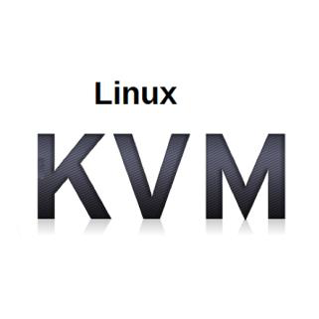






Network Application Hosting Spectrum
Script Hosting
Python
Access platform
details
Integrate with events
Utility Hosting
Linux utilities
RPMs
Containers
Application Code + Dependencies
LXC and Docker
support
Small VM
Complete control
Limited resource
needs
Linux KVM
Full Compute
Significant resource needs
Bare-metal or
Hypervisor

Slide 12


Cisco Application Hosting Technologies
Script Hosting
Utility Hosting
Containers
Small VM
Full Compute
• Python • Linux utilities
• Access platform • RPMs
details
• Integrate with events
• Application Code + Complete control
^{Dependencies} • Limited resource
• LXC and Docker _{needs}
^{support} • Linux KVM
UCS
Express
• Significant resource needs
• Bare-metal or
Hypervisor
Guest Shell
Cisco IOx

Slide 13












What is the Guest Shell?
64-bit Linux environment running on IOS XE and NX-OS platforms
Install, update, and operate 3rd party Linux apps (e.g. Puppet, Chef, Splunk)
Bundled with Python
Intended for agent or script
hosting
Linux applications
Guest Shell
Open Application Container
API
Network OS

Slide 14
What is Cisco IOx?
Host applications and services at the network edge across different hardware platforms
A compute platform, application framework, and software development kit
Manage life cycle aspects of
applications
Cisco IOx
Application
+
Linux
+
Cisco IOS

Slide 15
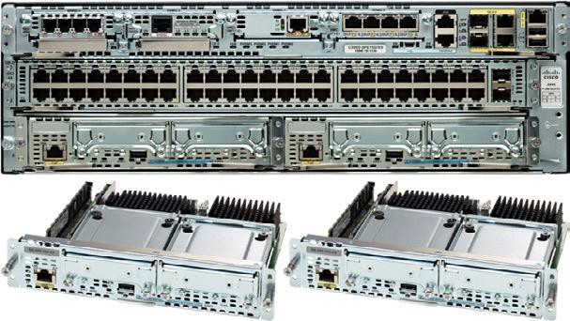
What is Cisco UCS Express
Cisco UCS Blade server installed and running in router/switch
Bare-metal or hypervisor
operating systems supported
Independent server
management (from network)

Slide 16
Guestshell

Slide 17
Cisco Application Hosting Technologies
Script Hosting
Utility Hosting
Containers
Small VM
Full Compute
• Python • Linux utilities
• Access platform • RPMs
details
• Integrate with events
• Application Code + Complete control
^{Dependencies} • Limited resource
• LXC and Docker _{needs}
^{support} • Linux KVM
UCS
Express
• Significant resource needs
• Bare-metal or
Hypervisor
Guest Shell
Cisco IOx

Slide 18
What is the Guest Shell?
64-bit Linux environment running on IOS XE and NX-OS platforms
Install, update, and operate 3rd party Linux apps (e.g. Puppet, Chef, Splunk)
Bundled with Python
Intended for agent or script
hosting
Linux applications
Guest Shell
Open Application Container
API
Network OS

Slide 19
General Guest Shell Preparation
IOS XE Steps
Enable IOX on the device
Configure guest shell network
connectivity
Enable Guest Shell
Configure environment DNS and proxy requirements within Guest Shell
NX-OS Steps
Guest Shell is enabled by
default on NX-OS
Configure environment DNS and proxy requirements within Guest Shell
© 2017 Cisco and/or its affiliates. All rights reserved. Cisco Confidential

Slide 20
Application Hosting: Networking
Container
10.0.0.10
Container
Container
VM
eth0
eth1
eth0
eth0
eth0
eth0
eth1
172.19.0.24
10.0.0.2
10.0.0.3
10.0.0.6
10.0.0.5
Mgmt Bridge0
Svc Bridge1
IOS XE
AppGigEthernet X
10.0.0.1/24
VirtualPortGroup X
Management VRF
Bridging
SVI
Routing
13.0.0.1
Ge0/0
Ge0/0/1
Ge0/0/2
Ge0/0/3
Ge0/0/11
Ge0/0/12
Ge0/0/13
172.19.0.23
L2 interface
12.0.0.1/24
12.0.0.2/24
12.0.0.3/24
L3 interface
Notes:
VPG = Virtual Port Group

Slide 21
IOS XE Step 1: Enabling IOx
IOx Manages the application
hosting on IOS XE
Guest Shell is just one use of
IOx
Notes
IOx service take 3 minutes to start
IOx service (HA) may not run
iosxe1#conf t iosxe1(config)#iox iosxe1(config)#exit
iosxe1#sh iox-service
Machine types supported
Machine types disabled
: LXC
: KVM
IOx Infrastructure Summary:
---------------------------
IOx service (CAF) : Running IOx service (HA) : Not Running IOx service (IOxman) : Running Libvirtd : Running
iosxe1#
Output edited for clarity
© 2017 Cisco and/or its affiliates. All rights reserved. Cisco Confidential

Slide 22
IOS XE Step 2: Create Virtual Port Group
Valid on routing platforms
only
Used to provide network connectivity to Guest Shell container
conf t
interface VirtualPortGroup 0
ip add 192.168.35.1 255.255.255.0
no shut
exit
Commands to be entered shown
© 2017 Cisco and/or its affiliates. All rights reserved. Cisco Confidential

Slide 23
IOS XE Step 3: Create NAT Entry
Valid on routing platforms only
Used to NAT traffic from Guest Shell off box
Example: to access Internet resources
Note: Inbound access to Guest Shell
requires additional NAT
Alternative to NAT is route to
VirtualPortGroup address space
conf t
interface VirtualPortGroup0
ip nat inside
! Interface connected to local network
interface GigabitEthernet1
ip nat outside
ip access-list standard NAT_ACL
permit 192.168.0.0 0.0.255.255
ip nat inside source list NAT_ACL \*
interface GigabitEthernet1 overload
Commands to be entered shown
* Command entered on single line in router
© 2017 Cisco and/or its affiliates. All rights reserved. Cisco Confidential

Slide 24
IOS XE Step 4: Enable Guest Shell
VPG and IP only needed on
routing platforms
Guest Shell Life-cycle
guestshell disable
Removes access and kills the
current session
Files and data are preserved
guestshell destroy
Deletes the guest shell file system
All data is lost
! Entered from Enable Mode (not config)
! All entered on single line
guestshell enable VirtualPortGroup 0
guest-ip 192.168.35.2
name-server 208.67.222.222
show app-hosting list
App id State
------------------------------------------
guestshell RUNNING
Commands to be entered shown
© 2017 Cisco and/or its affiliates. All rights reserved. Cisco Confidential

Slide 25
Accessing and Using Guest Shell
Linux commands can be run
directly from the IOS CLI
Log into guest shell by running
guestshell run bash
The Linux environment can be customized by editing .bashrc or .bash_profile
iosxe1#guestshell run pwd
/home/guestshell
iosxe1#guestshell run bash
[guestshell@guestshell ~]$ ls -l
total 0
[guestshell@guestshell ~]$ ping 8.8.8.8
PING 8.8.8.8 (8.8.8.8) 56(84) bytes of data.
64 bytes from 8.8.8.8: icmp_seq=2 ttl=62 time=70.5 ms
64 bytes from 8.8.8.8: icmp_seq=3 ttl=62 time=70.1 ms
^C
--- 8.8.8.8 ping statistics ---
3 packets transmitted, 2 received, 33% packet loss,
time 2008ms
rtt min/avg/max/mdev = 70.108/70.345/70.583/0.356 ms [guestshell@guestshell ~]$
Commands to be entered shown
© 2017 Cisco and/or its affiliates. All rights reserved. Cisco Confidential

Slide 26
Environment Setup: DNS Servers and Proxies
DNS resolution within Guest Shell independent of host platform
IOS XE configures name-server within guestshell enable
NX-OS must explicitly configure
within /etc/resolv.conf
Any required proxies must be configured on both IOS XE and NX-OS
[guestshell@guestshell ~]$ cat /etc/resolv.conf nameserver 208.67.222.222
[guestshell@guestshell ~]$ ping pool.ntp.org -c 1 PING pool.ntp.org (128.138.141.172) 56(84) bytes of data.
64 bytes from utcnist2.colorado.edu (128.138.141.172): icmp_seq=1 ttl=62 time=91.3 ms
Commands to be entered shown
© 2017 Cisco and/or its affiliates. All rights reserved. Cisco Confidential

Slide 27
Accessing the CLI from the Guest Shell
dohost command built into Guest Shell
Send commands directly to the router
Limited to exec privilege commands. No access to config mode.
[guestshell@guestshell ~]$ dohost 'show ip int bri'
Interface | IP-Address | OK? | Method | Status | Protocol
GigabitEthernet1 | 10.0.2.15 | YES | DHCP | up | up
GigabitEthernet2 | unassigned | YES | unset | administratively | down down
GigabitEthernet3 | unassigned | YES | unset | administratively | down down
VirtualPortGroup0 | 192.168.35.1 | YES | manual | up | up
[guestshell@guestshell ~]$ dohost 'show log | inc DHCP'
*Jul 27 18:51:09.796: %DHCP-6-ADDRESS_ASSIGN: Interface GigabitEthernet1 assigned DHCP address 10.0.2.15, mask 255.255.255.0, hostname iosxe1
© 2017 Cisco and/or its affiliates. All rights reserved. Cisco Confidential

Slide 28
Installing Applications within Guest Shell
YUM
Package manager for Linux systems.
Install, update and remove applications
’repos’ or file repositories
Git
Installed via yum
Access code from GitHub and other repositories
Useful for distribution of custom
applications.
[guestshell@guestshell ~]$ sudo yum install git
Loaded plugins: fastestmirror
=====================================================================================================================
Package Arch Version Repository Size
=====================================================================================================================
Installing:
git x86_64 1.8.3.1-6.el7_2.1 base 4.4 M
Installed:
git.x86_64 0:1.8.3.1-6.el7_2.1
Complete!
[guestshell@guestshell ~]$ git –version git version 1.8.3.1
© 2017 Cisco and/or its affiliates. All rights reserved. Cisco Confidential
Output edited for brevity and clarity

Slide 29
Using Python for Network Programming
”On-Box” Python ”Off-Box” Python
Python
Device OS
 | Python
 |  | API
Device OS
Scripts executed locally on switch
or router
Ideal for
Provisioning (ie ZTP)
Automating event responses (ie EEM)
Application Development
IOT
Scripts executed externally from
switch or router
Use API to interact with network
Ideal for
Configuration management automation
Telemetry/operational data
Controller use cases
© 2017 Cisco and/or its affiliates. All rights reserved. Cisco Confidential

Slide 30


On-Box Python Features in IOS XE and NX-OS
Interactive Python prompt
Run Python scripts directly on box
Includes a Cisco Python API library
for interacting with host device
Integration with Day Zero Deployment (ZTP and POAP)
Call Python Scripts with Embedded
Event Manager (EEM)
© 2017 Cisco and/or its affiliates. All rights reserved. Cisco Confidential

Slide 31
Interactive Python Prompt
At enable prompt guestshell run python
Interactive prompt inside a secured Guest Shell environment on the
device
Run Python commands right on box
iosxe1#guestshell run python
Python 2.7.5 (default, Jun 17 2014, 18:11:42)
[GCC 4.8.2 20140120 (Red Hat 4.8.2-16)] on linux2
Type "help", "copyright", "credits" or "license" for more information.
>>> x = "hello world"
>>> print(x)
hello world
>>>
Output edited for brevity and clarity
© 2017 Cisco and/or its affiliates. All rights reserved. Cisco Confidential

Slide 32
Python Script
At enable prompt
guestshell run python /flash/script_name.py [args]
#guestshell run ls /flash/netprog_basics/application_hosting/python_onbox
hello_world.py
! Single line command
# guestshell run python
/flash/netprog_basics/application_hosting/python_onbox/hello_world.py
Hello World!
Output edited for brevity and clarity
© 2017 Cisco and/or its affiliates. All rights reserved. Cisco Confidential

Slide 33
Installing Python Libraries
Use pip just like any other Python Environment*
sudo pip install <module>
iosxe1#guestshell run bash
[guestshell@guestshell ~]$ sudo pip install requests
Collecting requests
.
.
Installing collected packages: chardet, certifi, urllib3, idna, requests
Successfully installed certifi-2017.7.27.1 chardet-3.0.4 idna-2.6 requests-
2.18.4 urllib3-1.22
[guestshell@guestshell ~]$
* Some libraries may not install due to memory or compiler issues depending on Guest Shell version and platform
© 2017 Cisco and/or its affiliates. All rights reserved. Cisco Confidential
Output edited for brevity and clarity

Slide 34
Cisco Python CLI API
Command | Description
cli.cli(cmd) | Runs cli command(s) and returns result. Example: cli(“sh ver ; sh int”)
cli.clid(cmd)* | Runs cli command(s) and returns JSON output. Example: clid(“sh ver ; sh int”)
cli.clip(cmd) | Runs cli command(s) and prints result Example: clip(“sh ver ; sh int”)
cli.configure(cmd)** | Run a list of configuration commands. Example: cli.configure([“int lo1”, ”no shut”])
cli.configurep(cmd) ** | Run a list of configuration commands and print result. Example: cli.configure([“int lo1”, ”no shut”])
Permits Python calls to use CLI commands directly and return results
Integrated into Python
interpreter inside Guest Shell
Enabled by adding library cli
import cli
* - NX-OS Only
** - IOS XE Only
© 2017 Cisco and/or its affiliates. All rights reserved. Cisco Confidential

Slide 35
Cisco Python API
iosxe1#guestshell run python >>> import cli >>> cli.cli("show ip int brief") '\nInterface IP-Address OK? Method Status Protocol\nGigabitEthernet1 10.10.20.21 YES NVRAM up up \nGigabitEthernet2 unassigned YES NVRAM administratively ..' >>> cli.clip("show ip int brief")
Interface | IP-Address | OK? | Method | Status | Protocol
GigabitEthernet1 | 10.10.20.21 | YES | NVRAM | up | up
GigabitEthernet2 | unassigned | YES | NVRAM | administratively | down down
GigabitEthernet3 | unassigned | YES | NVRAM | administratively | down down
VirtualPortGroup0 | 192.168.35.1 | YES | NVRAM | up | up
Output edited for brevity and clarity
© 2017 Cisco and/or its affiliates. All rights reserved. Cisco Confidential

Slide 36
Cisco Python API
>>> cli.configurep(["int loop100", "desc Python Loop", "ip add 192.168.0.1
255.255.255.0"])
Line 1 SUCCESS: int loop100 Line 2 SUCCESS: desc Python Loop
Line 3 SUCCESS: ip add 192.168.0.1 255.255.255.0
>>> cli.clip("sh run int loop100") Building configuration...
Current configuration : 92 bytes
!
interface Loopback100
description Python Loop
ip address 192.168.0.1 255.255.255.0
end
Output edited for brevity and clarity
© 2017 Cisco and/or its affiliates. All rights reserved. Cisco Confidential

Slide 37







Day Zero Provisioning
(IOS XE/XR = ZTP / NX-OS POAP)
Automates process of upgrading
images and installing configurations
Utilizes DHCP for new device to find information
Option 150 – provides location of TFTP
server that contains the Python script
Option 67 – Python script file path on
TFTP server
Returned script might have basic copy information to install both image and configuration file
2
DHCP
1
Startup Config?
Network Device
Guest Shell
5
3
4
Script
TFTP
Python
Script
Config
© 2017 Cisco and/or its affiliates. All rights reserved. Cisco Confidential

Slide 38
Embedded Event Manager
Configure the event manager applet to run a Python script in response
to the event
iosxe1(config)#event manager applet interface_Lo100_Shutdown
iosxe1(config-applet)#event syslog pattern "Interface Loopback100, changed
state to administratively down"
iosxe1(config-applet)#action 0.0 cli command "en"
iosxe1(config-applet)#action 1.0 cli command "guestshell run python
/flash/netprog_basics/application_hosting/python_onbox/eem_intf_up.py lo100"
iosxe1(config-applet)#exit
Output edited for brevity and clarity
© 2017 Cisco and/or its affiliates. All rights reserved. Cisco Confidential

Slide 39
Embedded Event Manager
Manually trigger the event
iosxe1#term mon
iosxe1#debug event manager action cli
iosxe1#conf t iosxe1(config)#int lo100 iosxe1(config-if)#shut
Output edited for brevity and clarity
© 2017 Cisco and/or its affiliates. All rights reserved. Cisco Confidential

Slide 40
Embedded Event Manager
Verify with debug logs
*Oct
*Oct
2 20:44:57.843: %LINEPROTO-5-UPDOWN: Line protocol on Interface Loopback100, changed state to down
2 20:44:57.843: %LINK-5-CHANGED: Interface Loopback100, changed state to administratively down
*Oct
*Oct
*Oct
*Oct
*Oct
2 20:44:57.850: %HA_EM-6-LOG: interface_Lo100_Shutdown : DEBUG(cli_lib) : : CTL : cli_open called.
2 20:44:57.850: %HA_EM-6-LOG: interface_Lo100_Shutdown : DEBUG(cli_lib) : : OUT : iosxe1>
2 20:44:57.851: %HA_EM-6-LOG: interface_Lo100_Shutdown : DEBUG(cli_lib) : : IN : iosxe1>en
2 20:44:57.861: %HA_EM-6-LOG: interface_Lo100_Shutdown : DEBUG(cli_lib) : : OUT : iosxe1#
2 20:44:57.861: %HA_EM-6-LOG: interface_Lo100_Shutdown : DEBUG(cli_lib) : : IN : iosxe1#guestshell run
python /flash/netprog_basics/application_hosting/python_onbox/eem_intf_up.py lo100
*Oct
2 20:44:59.576: %HA_EM-6-LOG: interface_Lo100_Shutdown : DEBUG(cli_lib) : : OUT : Line 1 SUCCESS:
interface lo100
*Oct
*Oct
*Oct
*Oct
*Oct
*Oct
*Oct
2 20:44:59.576: %HA_EM-6-LOG: interface_Lo100_Shutdown : DEBUG(cli_lib) : : OUT : Line 2 SUCCESS: no shut
2 20:44:59.576: %HA_EM-6-LOG: interface_Lo100_Shutdown : DEBUG(cli_lib) : : OUT :
2 20:44:59.576: %HA_EM-6-LOG: interface_Lo100_Shutdown : DEBUG(cli_lib) : : OUT :
2 20:44:59.577: %HA_EM-6-LOG: interface_Lo100_Shutdown : DEBUG(cli_lib) : : OUT : iosxe1#
2 20:44:59.577: %HA_EM-6-LOG: interface_Lo100_Shutdown : DEBUG(cli_lib) : : CTL : cli_close called.
2 20:44:59.577:
2 20:44:59.577: tty is now going through its death sequence
*Oct
*Oct
2 20:45:01.541: %LINEPROTO-5-UPDOWN: Line protocol on Interface Loopback100, changed state to up
2 20:45:01.542: %LINK-3-UPDOWN: Interface Loopback100, changed state to up
Output edited for brevity and clarity
© 2017 Cisco and/or its affiliates. All rights reserved. Cisco Confidential

Slide 41

Demo Time!
guestshell
hello_world.py

Slide 42
IOx

Slide 43
Cisco Application Hosting Technologies
Script Hosting
Utility Hosting
Containers
Small VM
Full Compute
• Python • Linux utilities
• Access platform • RPMs
details
• Integrate with events
• Application Code + Complete control
^{Dependencies} • Limited resource
• LXC and Docker _{needs}
^{support} • Linux KVM
UCS
Express
• Significant resource needs
• Bare-metal or
Hypervisor
Guest Shell
Cisco IOx

Slide 44
What is Cisco IOx?
Enables hosting applications at the network edge across different hardware platforms
A compute platform, application framework, and software development kit
Manage life cycle aspects of
applications
Cisco IOx
Application
+
Linux
+
Cisco IOS
© 2017 Cisco and/or its affiliates. All rights reserved. Cisco Confidential

Slide 45
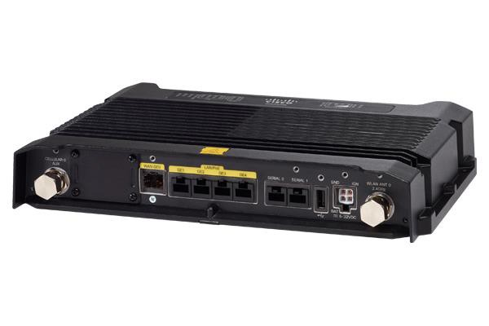
Why Cisco IOx?
Distributed Compute
Run, manage and monitor
applications within the Fog
Secure Communications
Use IOS networking and security
services
Powerful Integration
Connect sensors to the cloud with IoT integration and middleware services
IOS
IOx
Routing/Switching Network Security Access Control
Compute
Application Management
© 2017 Cisco and/or its affiliates. All rights reserved. Cisco Confidential

Slide 46





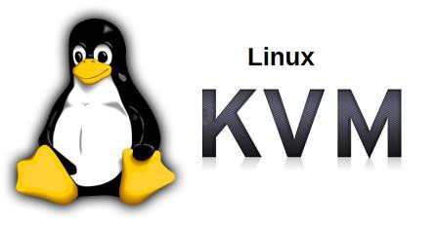
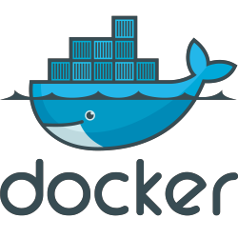
IOx Applications
Packages of code and
resources deployed to IOx
Choice of language
Packaging Types
Containerized
Linux Container (LXC)
Docker Tooling
Virtual Machine (KVM)
Platform as a Service
(Python and Java)
© 2017 Cisco and/or its affiliates. All rights reserved. Cisco Confidential

Slide 47
IOx Supported Platforms
https://developer.cisco.com/docs/iox/#!platform-support-matrix/platform-support-matrix
© 2017 Cisco and/or its affiliates. All rights reserved. Cisco Confidential

Slide 48
Cisco IOx Core Components
Cisco Application Hosting Framework (CAF)
The application framework that runs at the edge on the device
IOx SDK
A software development kit that helps packaging an application to make it IOx-ready
ioxclient
A command-line utility to help developers to interact with CAF, packaging
IOx Local Manager
A web management interface resident with the CAF to manage a local device
Fog Director
Management software running in the network that manages application lifecycle at scale
© 2017 Cisco and/or its affiliates. All rights reserved. Cisco Confidential

Slide 49
Cisco IOx Application Development Overview
Performed on the Workstation
Code
Compile / Link
Test / Debug
Package
Start
Performed on the IOx platform
Upload
Install
Configure
Test / Debug
Release

Slide 50
IOx Applications
Types of Applications
Docker
Support for using the Docker toolchain to deploy IOx applications has been added to
IOx 1.2
Kernel Virtual Machine (KVM)
A VM application is a virtual machine that contains the full OS (kernel and root filesystem) along with the application code and dependencies in a single package.
Linux Container (LXC)
A Container application is a single package of the root file system, application code and dependencies like libraries and native binaries.

Slide 51
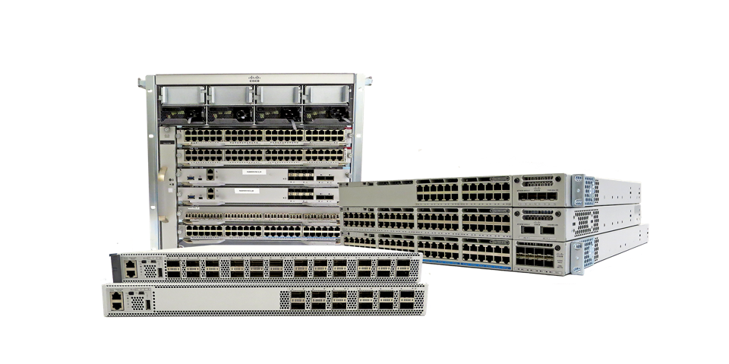
Native Docker Support
Catalyst 9000
Catalyst 9300 – 16.12.1 Catalyst 9400 - 17.1.1 Catalyst 9500 * Catalyst 9600 *
Note: Catalyst 9200 do not support Application Hosting
* Roadmap

Slide 52

Application Development - Docker
An open platform for developing, shipping, and running applications.
Allow to package an application with all of its dependencies into a standardized unit for software development.
Native Docker App
C9K supports native Docker container starting from IOS XE 16.12 release.

Slide 53

Why Docker ?
Virtual Machine Includes application, binaries & libraries, an entire guest OS.
Docker Container format for Linux containers that makes the process of creating and maintaining containers easier.
}
App A
App B
GBs
Bins/Libs
Bins/Libs
Guest OS
Guest OS
Hypervisor
Host OS
Server
}
App A
App B
MBs
Bins/Libs
Bins/Libs
Docker Engine
Host OS
Server

Slide 54
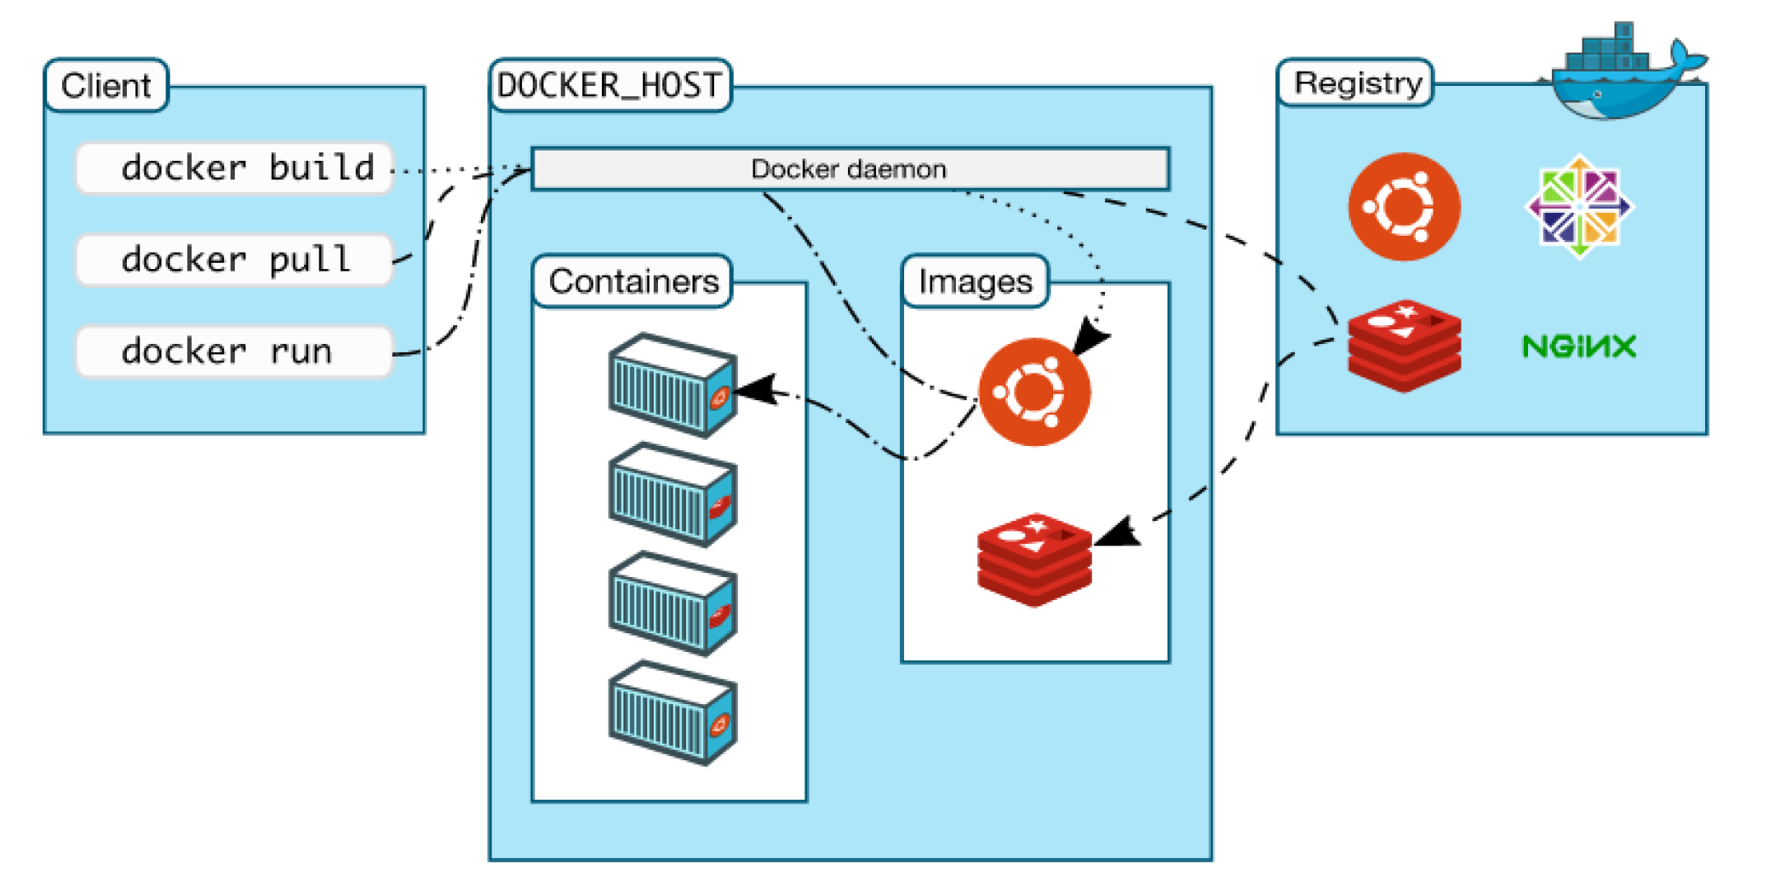
Docker Architecture
Notes:
Docker client
It is the primary user interface to Docker. It accepts commands from the user and communicates back and forth with a Docker daemon.
Docker daemon
It runs on a host machine. The user does not directly interact with the daemon, but instead through the Docker client with the RESTful api or sockets.

Slide 55
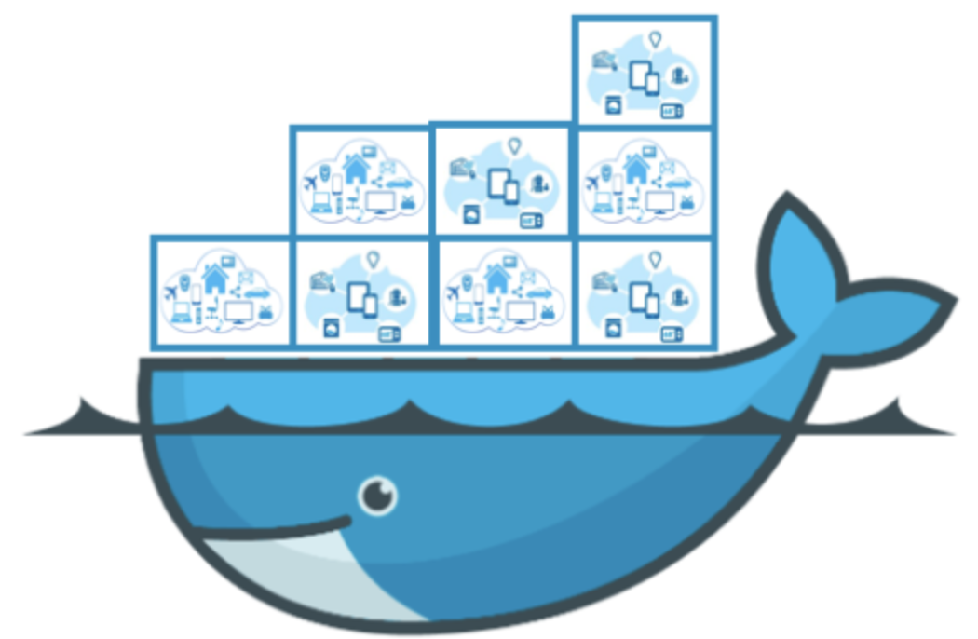
Docker Benefits
Fast (deployment, migration, restarts)
Secure
Lightweight (save disk & CPU)
Open Source
Simplify DevOps
Version control capabilities
Notes:
Flexible: Even the most complex applications can be containerized.
Lightweight: Containers leverage and share the host kernel.
Interchangeable: You can deploy updates and upgrades on-the-fly.
Portable: You can build locally, deploy to the cloud, and run anywhere.
Scalable: You can increase and automatically distribute container replicas.
Stackable: You can stack services vertically and on-the-fly.

Slide 56
Docker Workflow – Docker Hub
1
Pull Docker Image
docker pull <app>
2
Deploy App
docker save myapp > myapp.tar
DockerTM

Slide 57
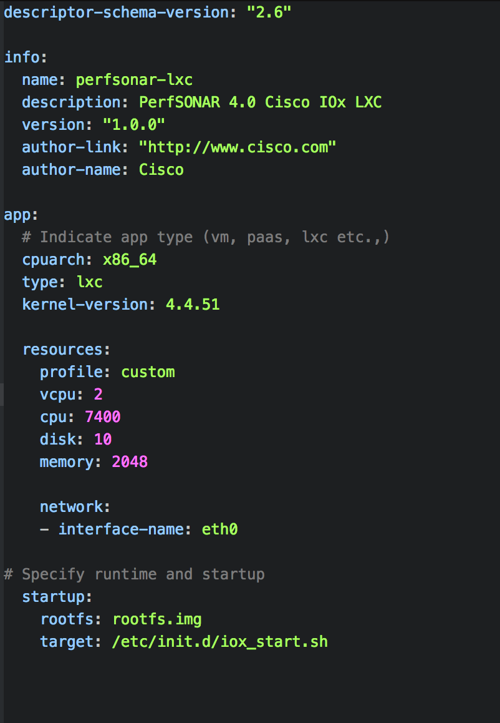
Docker Workflow -Custom App
Dockerfile
2
Build Docker Image
1
docker build -t <app> .
FROM ubuntu:18.04 as base RUN apt-get update -yq && apt-get install -yq python COPY poll-temperature.py /usr/bin/poll-temperature.py RUN chmod 777 /usr/bin/poll-temperature.py CMD /usr/bin/poll-temperature.py
3
Deploy App
docker save myapp > myapp.tar
Application File
App Descriptor (Optional)
#!/usr/bin/Python
import time import os
os.makedirs("/var/volatile/log") f = open('/var/log/poll-temp.log', 'w’)
while (1): s = "%s %s polling temperature ...\n" % (time.strftime("%d/%m/%Y"), time.strftime("%I:%M:%S")) f.write(s) f.flush() time.sleep(5)
DockerTM

Slide 58










Validated Apps- DevNet Eco System Exchange
tshark
ISC DHCP Server
iPerf
Cisco will not provide any support to third-party apps and open source apps unless specifically called out.
Such apps, however, will be validated for compatibility on Cisco® Catalyst® 9000 switches.
DevNet ecosystem will indicate the partners who have worked on Cisco Catalyst 9000 switches.

Slide 59
Application Management
Cisco DNA Center
Cisco DNA-C
CLI
Fog
Director
CLI
CLI
REST
REST
REST
Cisco Application Framework
Docker
Docker
Docker
Docker
Docker
3rd
Party App
3rd Party App
3rd Party App
Custom App
Custom App
Host OS (IOS XE Kernel)

Slide 60
Application Hosting: Networking
C9K
Container
10.0.0.10
Container
Container
VM
eth0
eth1
eth0
eth0
eth0
eth0
eth1
172.19.0.24
10.0.0.2
10.0.0.3
10.0.0.6
10.0.0.5
Mgmt Bridge0
Svc Bridge1
IOS XE
AppGigEthernet X
10.0.0.1/24
VirtualPortGroup X
Management VRF
Bridging
SVI
Routing
13.0.0.1
Ge0/0
Ge0/0/1
Ge0/0/2
Ge0/0/3
Ge0/0/11
Ge0/0/12
Ge0/0/13
172.19.0.23
L2 interface
12.0.0.1/24
12.0.0.2/24
12.0.0.3/24
L3 interface
Notes:
VPG = Virtual Port Group

Slide 61

App Management: IOS XE CLI
cat9k# conf t
cat9k(config)# iox
cat9k(config)# ip http server
cat9k# sh iox-service
...
IOx Infrastructure Summary:
---------------------------
IOx service (CAF) : Running
IOx service (HA) : Running
IOx service (IOxman) : Running
Libvirtd : Running
Enable and Verify

Slide 62
App Lifecycle Management – State Transitions
app-hosting install appid myapp package usbflash1:myapp.tar
app-hosting activate appid myapp
app-hosting start appid myapp
install
activate
start
uninstall
deactivate
stop
app-hosting stop appid myapp
app-hosting deactivate appid myapp
app-hosting uninstall appid myapp
Notes:
INSTALL/DEPLOYED: Application is installed on the device. Resources needed by the application is not committed to the application.
ACTIVATED: The resources required by the application is now committed. Associated container artifacts are also generated.
START/RUNNING: Application is now running
STOPPED : Application is stopped.

Slide 63
List Applications
Switch# sh app-hosting list
App id State
-----------------------------------------------
myapp RUNNING
Sample_app DEPLOYED
Switch# sh app-hosting detail appid myapp
State : RUNNING
Author : Cisco Systems, Inc.
Application
Type : Docker
App id : myapp
Version : 3.4
Description : Lubuntu based myapp
Resource reservation
Memory : 1792 MB
Disk : 10 MB
CPU : 6600 units
VCPU : 2
Network interfaces
eth0:
MAC address: 52:54:dd:cd:0f:d4
IPv4 address: 172.26.249.202
show app-hosting list
show app-hosting detail

Slide 64
App Resources Configuration
Reserved resource specified in app package can be overridden by setting a custom resource profile
Only cpu, memory, vcpu resource can be changed
Application config vnic and resource changes will only take effect by the next “app-hosting activate” command.
Resource values are application specific and any adjustments need to ensure that the app can run reliably with the new changes.
Switch#conf t Switch(config)# app-hosting appid myapp
Switch(config-app-hosting)# app-resource profile custom
Switch (config-app-resource-profile-custom)# cpu 7400
Switch (config-app-resource-profile-custom)# memory 2048
Switch (config-app-resource-profile-custom)# vcpu 2
app-resource profile custom
Notes:
Application config vnic and resource changes will only take effect by the next “app-hosting activate” command.
(i.e. if the app is already running, stop > deactivate > activate > start is required to use the new resource changes)

Slide 65
Docker CLIs
IOS CLI | Docker Commands
app-hosting connect appid MYAPP session | docker exec /bin/sh
app-hosting data appid MYAPP copy | docker cp
app-hosting activate appid MYAPP | docker create
app-hosting connect appid MYAPP session CMD | docker exec
app-hosting install appid MYAPP package <MYAPP.tar> | docker load
app-hosting move appid MYAPP log | docker logs
show app-hosting list | docker ps
app-hosting deactivate appid MYAPP | docker rm
app-hosting uninstall appid MYAPP | docker rmi
app-hosting start appid MYAPP | docker start
show app-hosting detail appid MYAPP | docker stats
app-hosting stop appid MYAPP | docker stop

Slide 66
Demo Time!
App-hosting CLI
IOx Local Manager
IOx Fog Director
DNAC App-hosting

Slide 67
Summary
Fog computing
App-hosting
Guestshell
Docker

Slide 68
Hands-on
Create a Python script to take desired action
Example : ”no shut” a given interface
csr1000v-4cpu(config)#int lo 100
csr1000v-4cpu(config-if)#shut
csr1000v-4cpu(config-if)#
*Apr 2 07:09:02.978: %LINEPROTO-5-UPDOWN: Line protocol on Interface Loopback100, changed state to down
*Apr 2 07:09:02.978: %LINK-5-CHANGED: Interface Loopback100, changed state to administratively down
*Apr 2 07:09:05.547: %SYS-5-CONFIG_P: Configured programmatically by process XEP_pnp_python from console as on vty4
*Apr 2 07:09:07.545: %LINEPROTO-5-UPDOWN: Line protocol on Interface Loopback100, changed state to up
*Apr 2 07:09:07.545: %LINK-3-UPDOWN: Interface Loopback100, changed state to up
csr1000v-4cpu(config-if)#

Slide 69
Continue to study..
Learn network programmability basics (DevNet Video Courses)
https://developer.cisco.com/video/net-prog-basics/
Python Tutorial
https://www.learnpython.org/
Docker
https://docs.docker.com/get-started/

